Slide 1
Day 2 Block 1
Aisling
Role Plays and Experiential
Link Practice to Theory & Theory to Practice

Slide 2
Let’s connect to a GSM Client that You’ve Struggled With

Slide 3
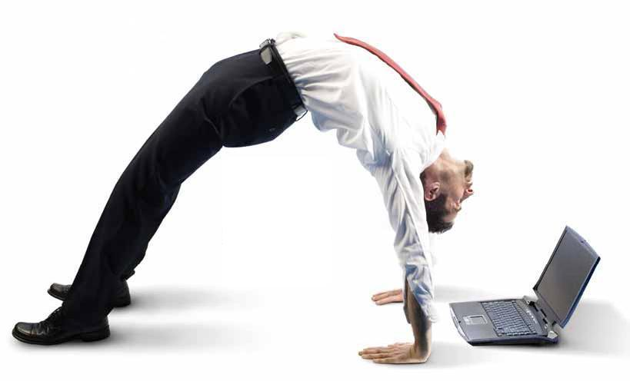
Role Play: GSM Client You’ve Struggled with
Connection to present moment
Emotions- Willingness to experience any fears & cultivating compassion
Clear on what is important, including relationships and community
Thoughts- Unhooked from Unwanted Thoughts about GSM Identity
Doing things that matter as a whole, present GSM person
Flexible Perspective Taking – Part of a Larger Community
(ACBS, 2015)

Slide 4
Your Turn: Connect to a GSM Client that You’ve Struggled With

Slide 5
What do you need now?
Sexuality Spectrum
No Mud, No Lotus
Common Humanity
Inside vs Outside Control
Anything else?

Slide 6
Day 2 Block 2
Matthew
Connecting with Loss

Slide 7
FAP GSM Loss Inventory
10 minutes to write down as many as you can think of

Slide 8
FAP GSM Loss Inventory
Real-Play – how to use the Loss Inventory
Trio discussion – client, therapist, and coach
Therapist – try to ask at least two deepening questions to evoke CRB2s
Coach – assist the therapist if you believe something could be followed up on
10 minutes to share a Loss
Cue therapist to deepen the discussion
2 more minutes to explore

Slide 9
Day 2 Block 3
Lisa Diamond

Slide 10
Day 2 Block 4
Mattling

Slide 11
Sources of Resilience (Glenda Russell’s response to the Orlando Massacre)
Cultivate a Movement Perspective
We are part of a community that extends across time and place, in this nation and beyond.
We are also connected to other movements for equality. We must keep this in mind and resist the temptation to see one person in another stigmatized group (the shooter) as representing all members of that group (Muslims, people of color, etc.). We all benefit from seeing the broader movement for equality as a struggle we all share.
It does not mean the movement is ending or even in trouble. It is part of a bigger backlash.
The movement will go forward despite these events, though it may not feel possible now.
We have the power to make that happen. It requires us to work, but is there any more important thing to do with our energies?

Slide 12
Sources of Resilience
Do Something
Active coping is virtually always better than doing nothing.
Read a book on queer history
Think of 10 good things about being LGBTQ.
Express your sadness, anger, and fear or whatever you’re feeling.
Get your friends together to talk about this event.
Send money to your local LGBTQ community center.
Volunteer with a community organization.

Slide 13
Sources of Resilience
Pay attention to your allies.
When danger is afoot, it is tempting to focus exclusively on possible sources of danger. While it is important to be as safe as possible, it is also important to focus on who your allies are. Movements rarely make progress solely through the efforts of people who are the targets of oppression. We need allies.
Pay at least as much attention to our allies as you do to the people who are against us.
Tell your straight and cis friends what you would like them to do.

Slide 14
Sources of Resilience
Watch for the negative messages about our community that may float around.
Actively resist such messages.
Learn the truth about who we are.
Read some LGBTQ history to remind yourself of what an amazing movement we have.
Read about LGBTQ elders and what they have accomplished.
Remember the words of the great South African freedom fighter, Steven Biko, who said, “The most potent weapon in the hands of the oppressor is the mind of the oppressed.”

Slide 15
Sources of Resilience
Find and make use of your LGBT and allied community.
Go where you feel safe. Play when you feel like it.
You’ll be contributing to the community even as you get good things form the community.
Support community events.
Use the Orlando tragedy as a way to re-energize yourself and your local community.
Have hot sex.
Look at everything you have ever gained from the LGBTQ community, and dare to pass it on to others.

Slide 16
Sources of Resilience
Do the usual things that help people.
Take care of yourself.
Get enough sleep.
Eat well.
Be careful what you put into your body.
Get some exercise.
Pay attention to the temptation to isolate.

Slide 17
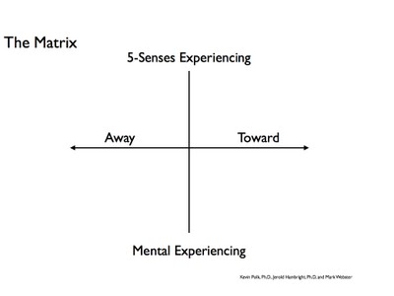
Let’s look at our lives in terms of workability
What are your away moves in your personal & professional life? Perhaps where it could be threatening to be identified as GSM or an ally?
What are your towards moves in your personal & professional life, where you are creating or encouraging GSM acceptance?
What are you trying to run away from in your personal & professional life regarding gender and sexuality?
What allows us to create GSM nurturing spaces?

Slide 18
Let’s look at our lives in terms of workability

Slide 19
Tonglen
Rehearsal for being in the presence of pain/suffering that cannot be mitigated
Practicing resilience for moments of leadership

Slide 20
Come back to your GSM client from yesterday
Has anything shifted?
How will you approach this client differently after this workshop?
Commit to changing one/two small things regularly with your GSM client based on what you’ve learned over the past two days

Slide 21
Headline of the San Francisco Chronicle
Female humpback whale who had become entangled in a spiderweb of crab traps and line weighted down by hundreds of pounds of traps that caused her to struggle to stay afloat.
She also had hundreds of yards of line rope wrapped around her body, tail, Torso, and a line tugging in her mouth. A fisherman spotted her just east of the Farallon Islands and radioed an environmental group for help.
Within a few hours, the rescue team arrived and determined that she was so bad off, the only way to save her was to dive in and untangle her. They worked for hours and eventually freed her.

Slide 22
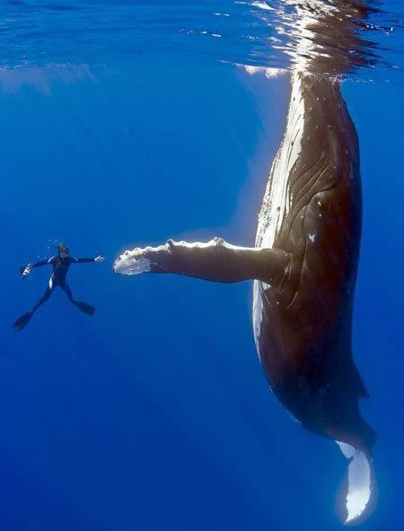
When she was free, the divers say
she swam in what seemed like
joyous circles. She then came back
to each and every diver, one at a time,
and nudged them, pushed them
gently around as she was thanking them. Some said it was the most
incredibly beautiful experience
of their lives. The guy who cut the rope out of her mouth said her eyes were following him the whole time, and he will never be the same.
Notes:
Recent headline of the San Francisco Chronicle.
Female humpback whale who had become entangled
in a spiderweb of crab traps and line weighted down
by hundreds of pounds of traps that caused her
to struggle to stay afloat. She also had hundreds
of yards of line rope wrapped around her body, tail,
Torso, and a line tugging in her mouth. A fisherman spotted her just east of the Farallon Islands
and radioed an environmental group for help.
Within a few hours, the rescue team arrived
and determined that she was so bad off,
the only way to save her was to dive in
and untangle her. They worked for hours
and eventually freed her.

Slide 23
May you, and all those you love, be so blessed and fortunate to be surrounded by people who will help you get untangled from the words and stories that are binding you.
And, may you always know
the joy of giving and receiving gratitude.
mskinta@paloaltou.edu
aisling@actnowireland.com

Slide 24
Questions? Comments?

